Slide 1
Rotting Research: How Link Rot Impacts the Integrity of Scholarly Publishing
Dr. Marshal A. Miller

Slide 2
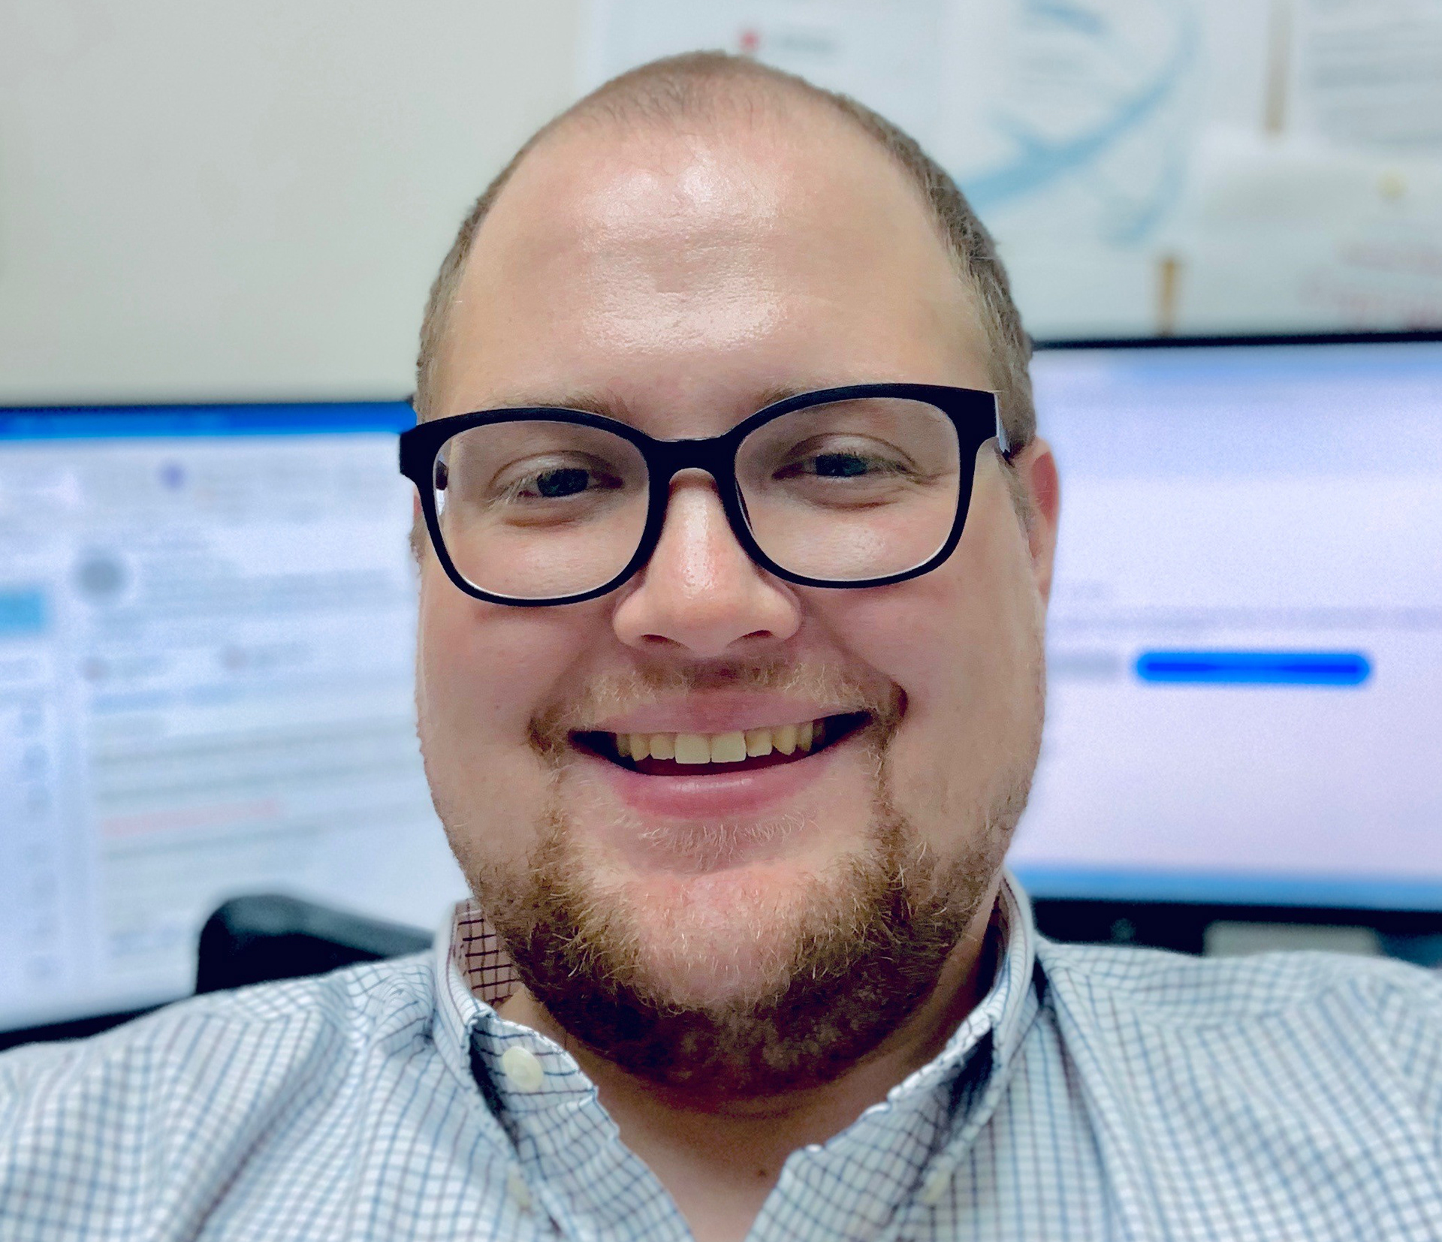
About Me
Dr. Marshal A. Miller
Assistant Professor
Computer & Information Science
Northampton Community College

Slide 3
Learning Objectives
By the end of this presentation, you will be able to:
Define link rot.
Describe the effect of link rot on scholarly research.
Discuss potential remediations.

Slide 4
What is Link Rot?
Link rot: The phenomenon of resources becoming inaccessible over time when their originally cited location is relocated or becomes permanently unavailable. ⁴

Slide 5

How Bad is It?
70% of internet addresses cited in articles published in the Harvard Law Review. ⁴
~50% of links in Supreme Court decisions. ⁴
Link Rot in Law
Notes:
About 12 years ago, The Berkman (Klein) Center for Internet and Society at Harvard Law School decided to conduct a study on the accessibility of the online resources cited in Supreme Court cases. This led to further studies into the publications of Harvard Law Review. This started research into the subject of link rot. This later expanded into other areas like content drift, where content changes over time, Reference Rot, specific to citations, and persistent identifiers. Which is where many of you are probably most familiar with this work. Many of you are probably thinking, what about DOIs, or Digital Object Identifiers?

Slide 6
But We Have DOIs
37% of DOI links were broken. ⁵
33% of DOI links to be broken on the institution’s internal network. ³
51.7% of DOIs were unreachable from outside of the institution’s network. ³
Notes:
Studies led to the formation of DOIs and other less well-known persistent identifiers. And I think a lot of us thought we had solved the issue. But in the last 5 years, studies have started to emerge about the efficacy of DOIs on mitigating research. These were the results. One study looked at DOIs at face value. Found that about 37% of these links were broken. Another study broke down the access based on institutional access. Some institutions have access behind the paywall, based solely on their network, not through a login. Over half of the links were broken from a public-facing machine, while 33% remained inaccessible, even with institutional access.

Slide 7
How Does This Affect Research?
Academics rely heavily on previous research. ⁹
References provide a method for others to retrace the steps a researcher took to establish their position. ⁶
Replication of studies is difficult, or impossible, without the ability to find reference resources. ⁹
Loss of verification calls into question the validity of literature reviews. ⁷
Notes:
So. Why does this matter? I’m sure you all have ideas, but here are some bullet points that came from the research conducted in this area. Basically, the foundation of research, as a discipline, is at the heart of this issue.

Slide 8
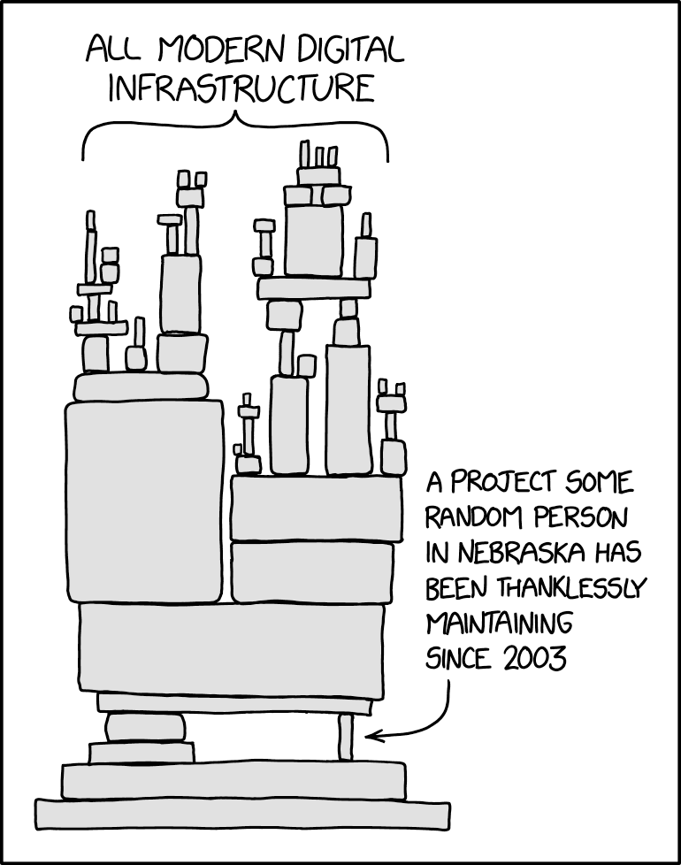
How Does This Affect Research?
Notes:
In open-source software, there is this meme that we always use and I feel like it applies here. There are a lot of things in our world that are built on top of something that is built on something else and that on something else and it’s usually some small thing that no one notices or remembers. We have seen this a few times in major security issues with things like heartblead with SSL encryption, run by 2 Steves, and Log4j more recently. Now if this was research and that one publication gets redacted or is no longer accessible, all the research that is built on top of it could crumble, but would we even know?

Slide 9
How Does This Affect Research?
Citations tend to decay over time because of a preference for recentness, even over seminal works. ¹
Only 30% of links in the sciences functioned after 4 years. ⁴
The average lifespan for a resource’s website was 9.3 years. ⁴
Unfortunately, only 62% of that data was archived. ⁴
Notes:
A story similar to the two Steves.
No one but Zwicky cited a study about galaxy clustering for 27 years and added that it was not seriously discussed for a total
of 41 years after its publication. Not that is a seminal work.

Slide 10
How Does This Affect Research?
Retracted Publications:
The number of retractions issued for research articles in 2023 passed 10,000 in early December. ⁸
Retractions to articles ratio rises 0.2% every year. ⁸
Wiley’s articles were cited more than 35,000 times. ⁸
Notes:
I asked before about retractions. This is becoming a bigger and bigger issue as well. Every year articles are retracted. Last year alone there were over 10,000 research articles retracted. This number rises every year. Just a subset of these articles were cited more than 35,000 times. Do you think they know? Who is double-checking that research and references. Replication used to be a huge part of research, but with the emphasis on publishing numbers, it has decreased. Could lead to more issues going unnoticed for many years.

Slide 11
Rotting Research: The Study
2,500 peer-reviewed scholarly articles.
Published between 2013 and 2022. 250 publications per year.
500 publications from each of the 5 disciplines:
Arts & Humanities
Business
Health and Medicine
Science, Math, and Technology
Social Sciences
Notes:
Research has previously focused on individual disciplines. (Aksnes et al., 2019).
Web of Science, Harvard Law Review, Supreme Court decisions.
In 2022, I decided to do my own study to see if this was isolated or impacted disciplines differently. The Dataset was far larger than any previous study had conducted.

Slide 12
Rotting Research: The Study
The overall percentage of broken links was 36%. ⁵
The overall percentage of broken DOIs was 37%. ⁵
Results aligned with previous studies. ⁵
Notes:
Here are some of the results. They aligned with all previous studies. But I can break them down a little bit more than some of the previous ones.

Slide 13
Rotting Research: The Study
Mean of broken links by academic domain. ⁵
Arts & Humanities – 39%
Business – 39%
Health & Medicine – 32%
Science, Math, & Technology – 34%
Social Sciences – 37%
Notes:
Here we have a breakdown of each of the disciplines and link rot.

Slide 14
Rotting Research: The Study
Mean of broken DOIs by academic domain. ⁵
Arts & Humanities – 42%
Business – 44%
Health & Medicine – 33%
Science, Math, & Technology – 23%
Social Sciences – 40%
Notes:
And now we look specifically at DOIs by discipline. Oddly enough, there is a much bigger disparity between disciplines when it comes to DOIs than when it came to links in general.

Slide 15
Other Findings
Publishers have internal policies to address DOIs.
Publishers hide their DOIs behind a paywall.
Publishers use 3rd-party services for their DOIs.
Notes:
The best link to use is the one most likely to provide continual access to the resource. ²
Without providing any means of checking the link besides logging in.
Most style guides advise pointing to a public abstract.
Crossref serves as one example that frequently appeared in 300-level response codes.
Using a third-party service adds another possible point of weakness in the process.

Slide 16
Other Findings
Style guides may play a part in this issue.
Study guides are updated at different intervals.
Some contain outdated information.
Notes:
One possible factor contributing to these percentage differences involves the use of different style guides.
Some study guides have changed more frequently than others, and some still contain outdated information in their most recent versions.

Slide 17
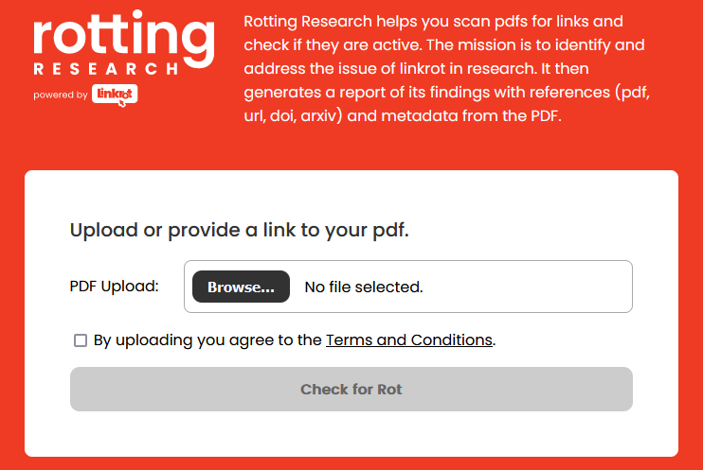
Rotting Research: The Project
Upload PDF
Checks for Links
Checks for DOIs
Downloadable Report
Notes:
Still trying to learn from all of this, I created an app that helps collect data on this. Basically, you upload a PDF, and it finds all the links in that document, and then checks if they are reachable. It will then return a report. It even breaks down the results by overall links and DOIs.

Slide 18
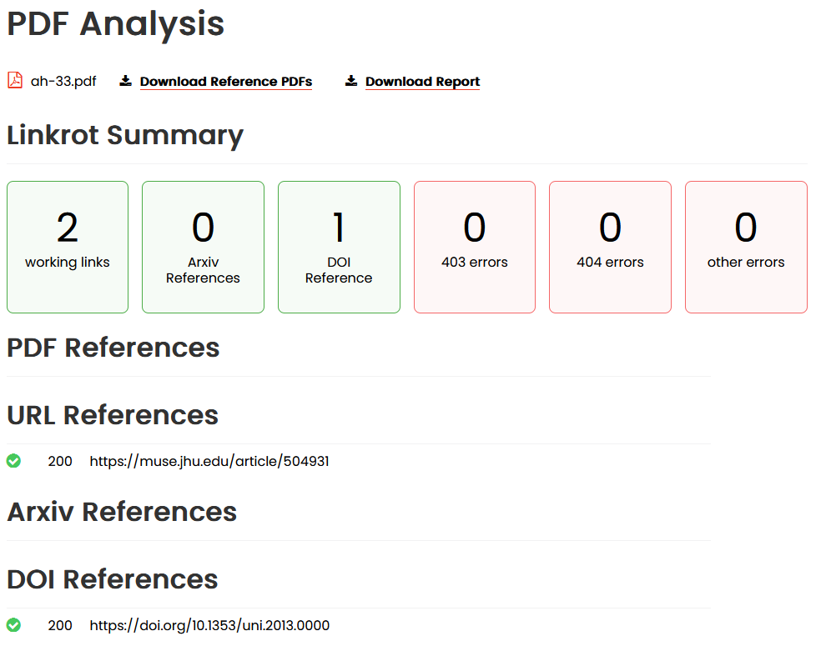
Rotting Research: The Plan
Archive via Internet Archive
Detect Retractions
Database for Future Studies
Change Detection
Notes:
Taking into consideration the evolving problem, our roadmap includes things like archiving all links with the Internet Archive and detecting any references that were retracted or changed content. We also hope to use the data from this site to create an even larger dataset to continue to monitor the situation.

Slide 19
Rotting Research: The Conversation
Content Drift
Citation Managers
Style Guides
3rd-Party Services
DOIs
Pre-Publishing
Role of Librarians
Iterative Citations
Library of Congress
Copyright
Future Research
Solutions
Notes:
Now, I want to hear what you have to say. I have put up some possible topics of discussion, but please feel free to take it in any direction.

Slide 20
Resources
Gerow, A., Hu, Y., Boyd-Graber, J., Blei, D. M., & Evans, J. A. (2018). Measuring discursive influence across scholarship. Proceedings of the National Academy of Sciences of the United States of America, 115(13), 3308–3313.
Homenda, N. (2021). Persistent URLs and Citations Offered for Digital Objects by Digital Libraries. Information Technology and Libraries (Online), 40(2), 1–12. http://dx.doi.org/10.6017/ital.v40i2.12987
Klein, M., & Balakireva, L. (2021). An extended analysis of the persistence of persistent identifiers of the scholarly web. International Journal on Digital Libraries. https://doi.org/10.1007/s00799-021-00315-w
Król, K., & Zdonek, D. (2020). Peculiarity of the bit rot and link rot phenomena. Global Knowledge, Memory and Communication, 69(1/2), 20–37. http://dx.doi.org/10.1108/GKMC-06-2019-0067
Miller, M. A. (2022). The Putrefaction of Digital Scholarship: How Link Rot Impacts the Integrity of Scholarly Publishing [Ed.D., Southeastern University]. In ProQuest Dissertations and Theses (2841257231). ProQuest Central. https://www.proquest.com/dissertations-theses/putrefaction-digital-scholarship-how-link-rot/docview/2841257231/
Notes:
Here are my references for this presentation.

Slide 21
Resources
Penders, B. (2018). Ten simple rules for responsible referencing. PLoS Computational Biology, 14(4), 1–6. https://doi.org/10.1371/journal.pcbi.1006036
Rubbo, P., Pilatti, L. A., & Picinin, C. T. (2019). Citation of Retracted Articles in Engineering: A Study of the Web of Science Database. Ethics & Behavior, 29(8), 661–679. https://doi.org/10.1080/10508422.2018.1559064
Van Noorden, R. (2023). More than 10,000 research papers were retracted in 2023—A new record. Nature. https://doi.org/10.1038/d41586-023-03974-8
West, R., Stenius, K., & Kettunen, T. (2017). Use and Abuse of Citations. In K. Stenius, T. F. Babor, R. Pates, M. Miovský, J. O’Reilly, & P. Candon (Eds.), Publishing Addiction Science (pp. 191–206). Ubiquity Press; JSTOR. https://www.jstor.org/stable/j.ctv3t5qxw.16

Slide 22

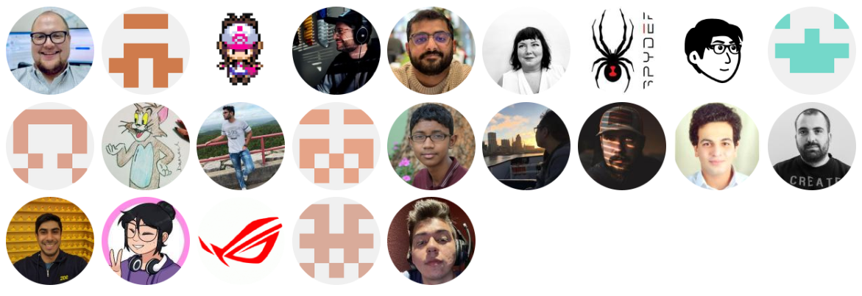
Contributors
https://rottingresearch.org
Notes:
I’d also like to thank those who have contributed to the project.

Slide 23

Leave Feedback
Thank you for attending our session and joining in the discussion.
https://rottingresearch.org
Contact me: mmiller@northampton.edu
https://app.keysurvey.com/f/41693657/5c14/
Notes:
Thank you for attending. Please fill out the feedback form. You can use the QR code or the link below it to find the form. Also, feel free to contact me at mmiller@northampton.edu and of course check out the project at rottingresearch.org

